Slide 1
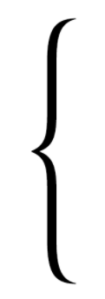
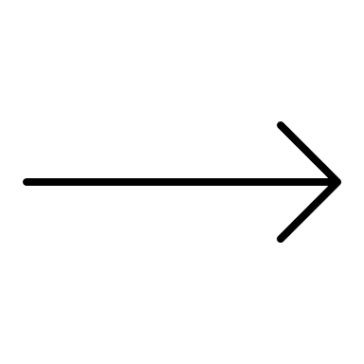

Backdrop
2m
Point of Disappearance
Ball (4, 5, 6 m/s left or right)
Target
Rectangle
visible (0.5s)
Invisible (0.5, 0.6, 0.7s)
10m
Observer (static or 3.6 m/s left/right)

Slide 2
2m
Target (4, 5, 6 m/s left or right)
10m
Observer (static or 3.6 m/s left or right)

Slide 3
